Slide 1
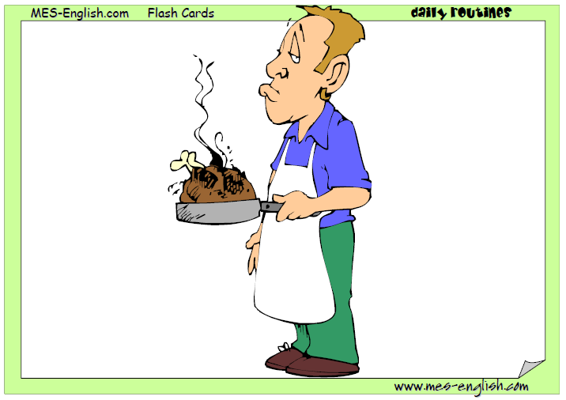
He is cooking

Slide 2
He is cooking

Slide 3
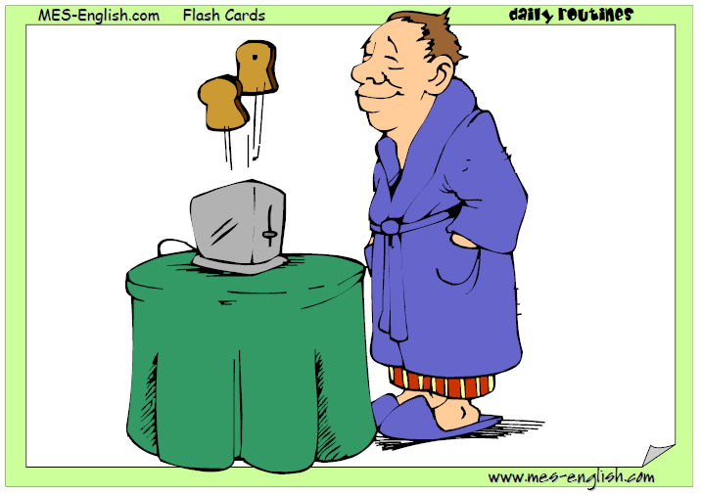
He is eating breakfast
He is having breakfast

Slide 4
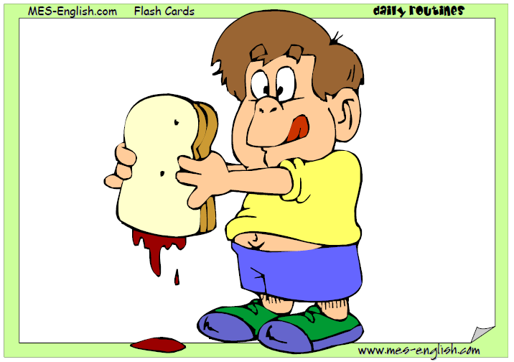
He is eating lunch
He is having lunch

Slide 5
He is having dinner
He is eating dinner

Slide 6
He is drinking

Slide 7
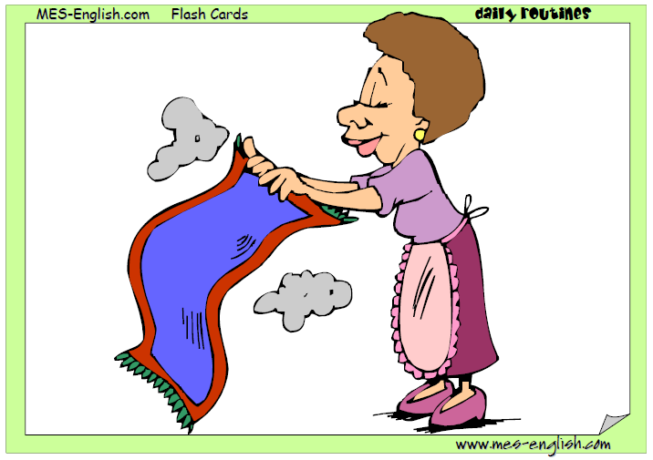
She is cleaning

Slide 8
He is walking

Slide 9
He is doing homework

Slide 10
He is reading

Slide 11
He is writing

Slide 12
He is studying

Slide 13
He is cleaning

Slide 14
He is drawing

Slide 15
He is playing the piano

Slide 16
He is watching TV

Slide 17
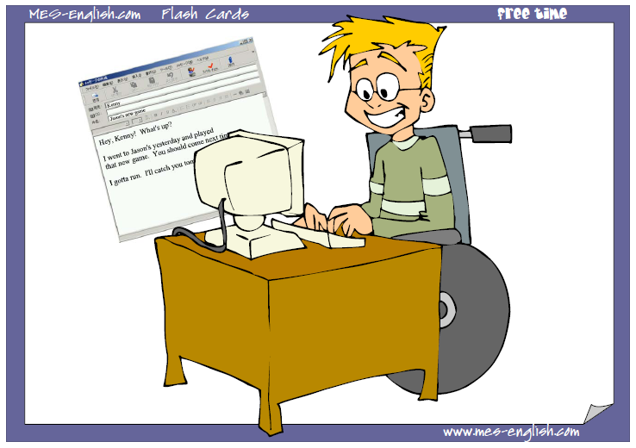
He is emailing friends

Slide 18
She is singing

Slide 19
She is dancing

Slide 20
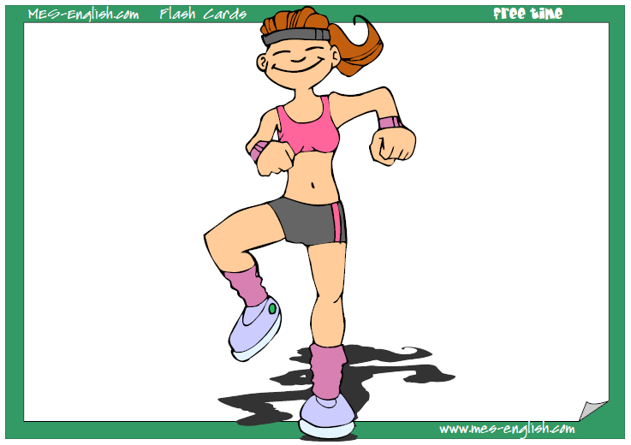
She is exercising

Slide 21
He is sleeping

